Slide 1

Period End Closing Key Process Areas and New Period End Checks
Currency Revaluation
G/L Closing Activities for Financial Statement Preparation
AP/AR Regrouping
Currency Translation
Functional Area Adjustment

Slide 2
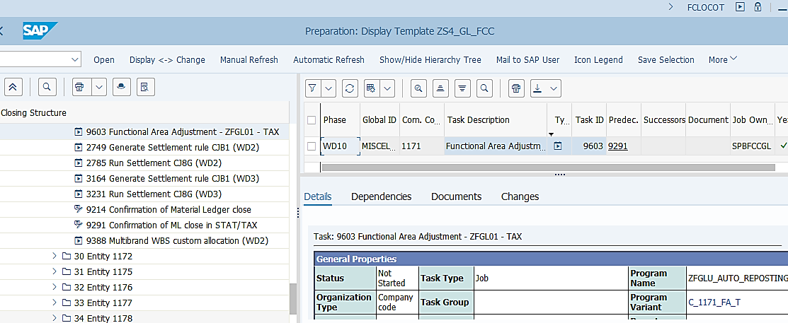
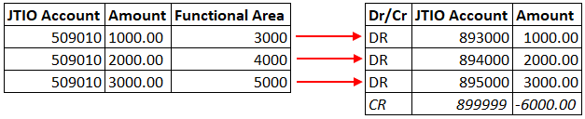
Functional Area Adjustments Process Overview
Basic Process of Functional Area Adjustments
Functional Area Adjustment is a process aimed to reclassify P&L amounts from posted “by nature” (e.g. Payroll, Rent, etc.) to “by function” (e.g. Administration, Miscellaneous, etc.).
During the month, expenses are accumulated on P&L expense accounts assigned to Functional Area via cost object (e.g. cost center).
As the result of Functional Area Adjustment – the accumulated expenses aggregated by Functional Area are re-posted to Functional Area adjustment GL accounts 89XXXX (where XXXX = Functional Area, e.g. 1000 for Direct Labor Expense, 2000 for General Production Expenses, etc,) using suspense GL account 899999 for offsetting entry as shown above.
The sum of amounts on Functional Area Adjustment accounts 89XXXX and 899999 should be zero after the execution of the transaction.
T-Code: ZFGL01¹⁾ ²⁾
This is a JTI custom development which is executed manually by GBS outside of FCC. The corresponding FCC task status needs to be updated by the GBS once it is completed.
Such treatment is a legal requirement in certain jurisdictions and is applicable to JTI SA, LUXCO, UK, GR, TR, KZ, and UA at the moment, but the functionality can be used for other entities if needed.
FCC Task: Entity Level
The Functional Area Adjustment tasks are set at entity level.
Timing:
WD9 – STAT/TAX
As this is a local requirement, the tasks are to be executed on WD9 following the STAT/TAX ledger closing deadlines.
¹⁾ For entities 1179, 1180 T-Code ZFGL2_FA_ADJ is used to perform Functional Area Adjustments, the process is the same as for T-code ZFGL01.
²⁾ This was a Note task prior to P5 2020 closing.

Slide 3
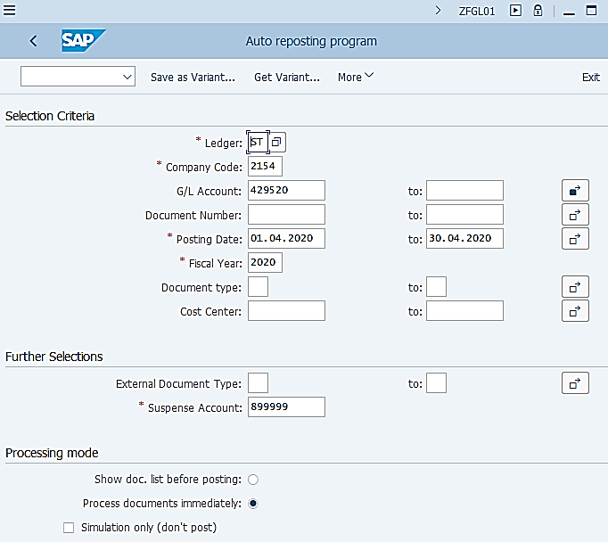
Functional Area Adjustment: Execution (1/3)
ZFGL01: Functional Area Adjustment
Functional Area Adjustment is a process which is only applicable to Statutory or/and Tax ledger (for certain countries). You can execute the transaction for one selected ledger only at one time. Individual variants have been set up for each entity in each ledger which require this process with input from the entities. In case such requirements change, entities should liaise with GBS to have the corresponding variants changed or any new variant created. There is no need to update FCC task as the FCC tasks are notes only.
The transaction can be executed for one entity at any one time.
Different entities select different G/L accounts for performing the Functional Area Adjustment. Again, these are confirmed by entities for each ledger where the process is required.
This is the selection of postings which need to be considered for Functional Area Adjustment. As this process is executed once a month, the posting date range should be from the first to last date of the month, in the corresponding Fiscal Year.
We do not normally need to restrict Document Type and Cost Centers when selecting which items should be included for Functional Area Adjustment. However you may need to use these fields for any extra run of this transactions for corrections purposes.
External Document Type allows to indicate which Document Types should be reposted by Functional Area with original document type. E.g. If we specify document type AF here, then AA depreciation will be re-classified by Functional Area with document type AF, same as the original Document Type. If we leave this field empty, then all monthly subject items will be re-classified with Document Type SA.
This is the G/L account that is used to balance FA adjustment to zero. It should always be 899999 and should not be changed.
Select this option to allow document to be displayed before postings are made. As FCC will need to run this transaction and make postings straight away, this option is not selected. However you may use it during manual execution outside of FCC.
This is the indicator to process all documents immediately, i.e. the list is not shown before user can confirm that the Functional Area Adjustment documents should be processed (posted). This option needs to be selected in the FCC variant as the transaction is run straightaway. Note that if you select this option, then the above one (Show doc list before posting) is automatically deselected and vice versa.
This is equivalent to Test Run. It should only be used if you wish to do a test run when executing this transaction outside of FCC manually.

Slide 4
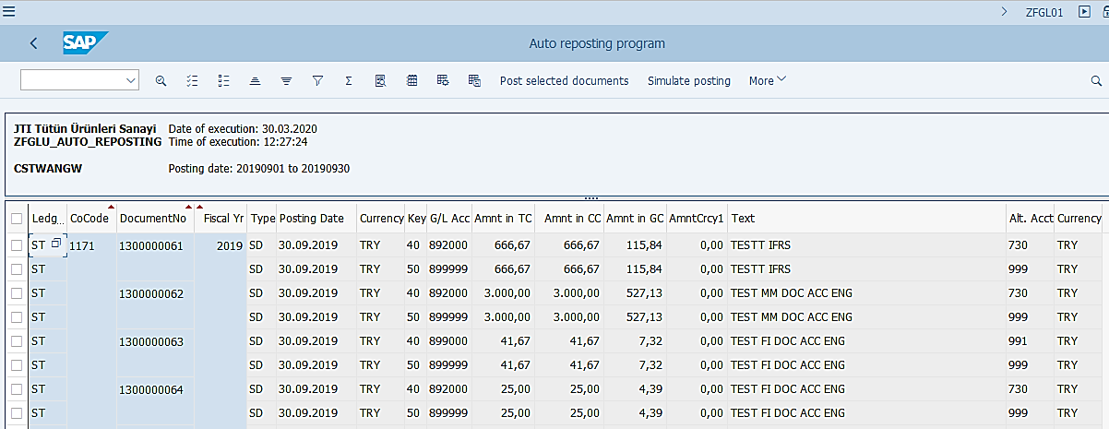
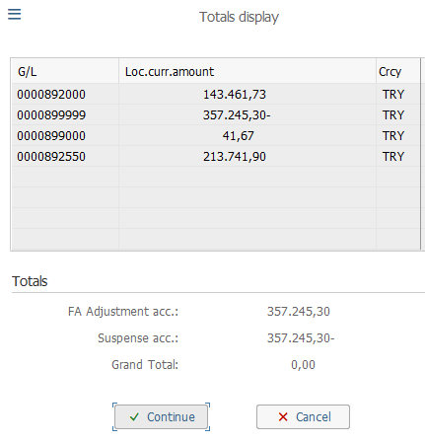
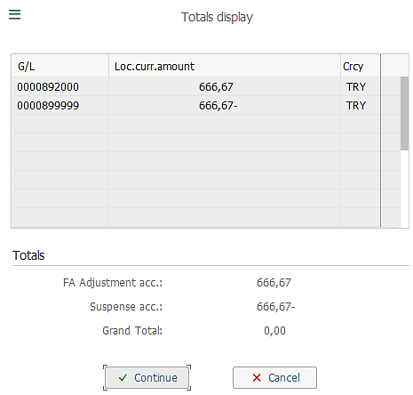
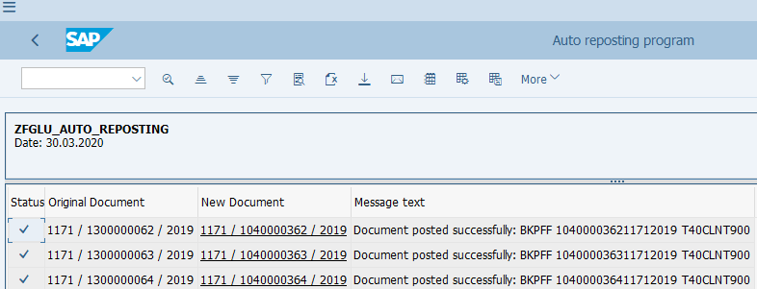
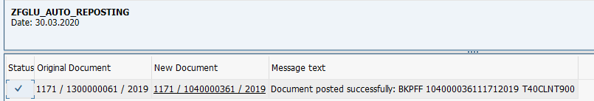
Functional Area Adjustment: Execution (2/3)
ZFGL01: Functional Area Adjustment
In this demonstration, which is a manual execution outside of FCC, we have had the following options selected:
Show doc list before posting
Simulation only (don’t post)
These options are NOT selected in the variant used by FCC.
Select All to post
Select Individual Doc to post
You can also select all the items upon review. In this case, once you select Simulate Posting or Post selected documents, you will be shown a small dialogue box which contain summarized values that are to be posted. If you have selected Post selected documents, upon Continue, your log will show all the document numbers that have been posted as shown below.
Upon your review, you may select individual item for Simulation or Posting. If you select posting of the individual item, you will be given a log showing the document number that is posted as shown below.

Slide 5
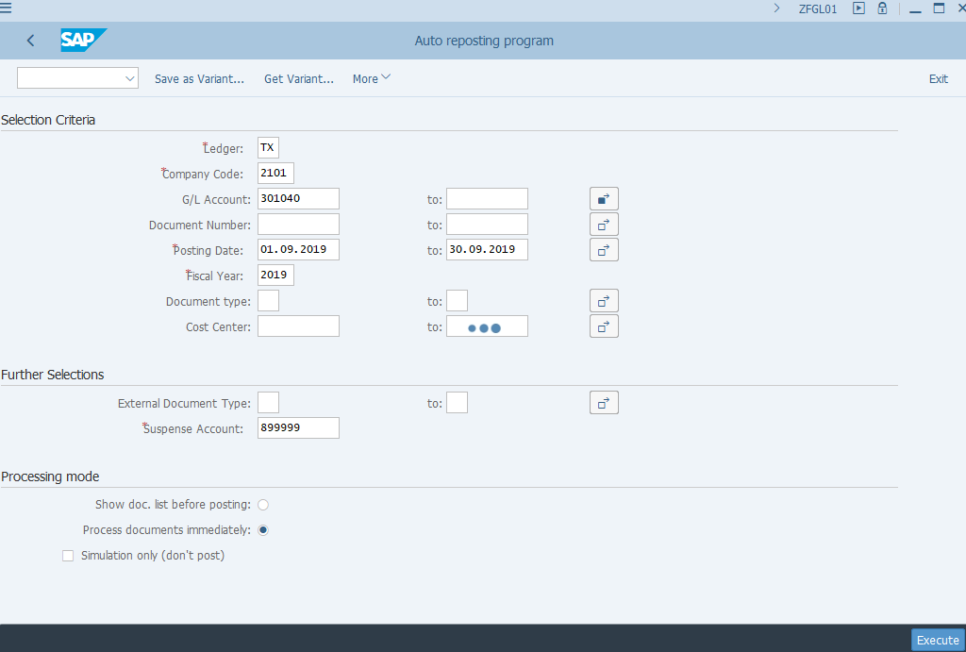
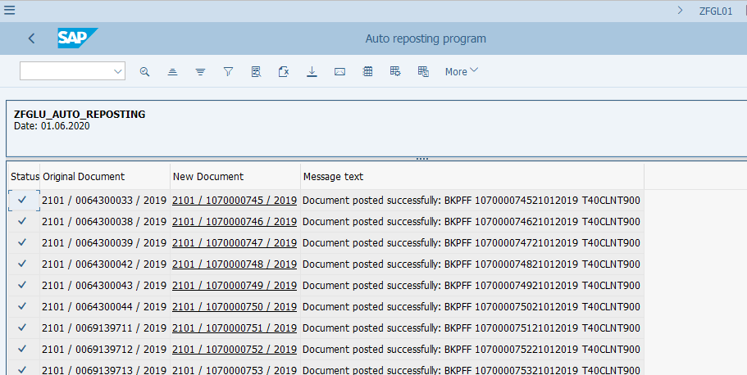
Functional Area Adjustment: Execution (3/3)
ZFGL01: Functional Area Adjustment
In the FCC variant, the option “Process documents immediately” is selected, while no simulation or show document option is selected. This will allow FCC to execute the transaction and post the documents straightaway.
As you can see in this example, if we use the FCC variant directly for manual execution, upon execution you receive the document numbers immediately without the opportunity to review the list or select which one you wish to post.

Slide 6
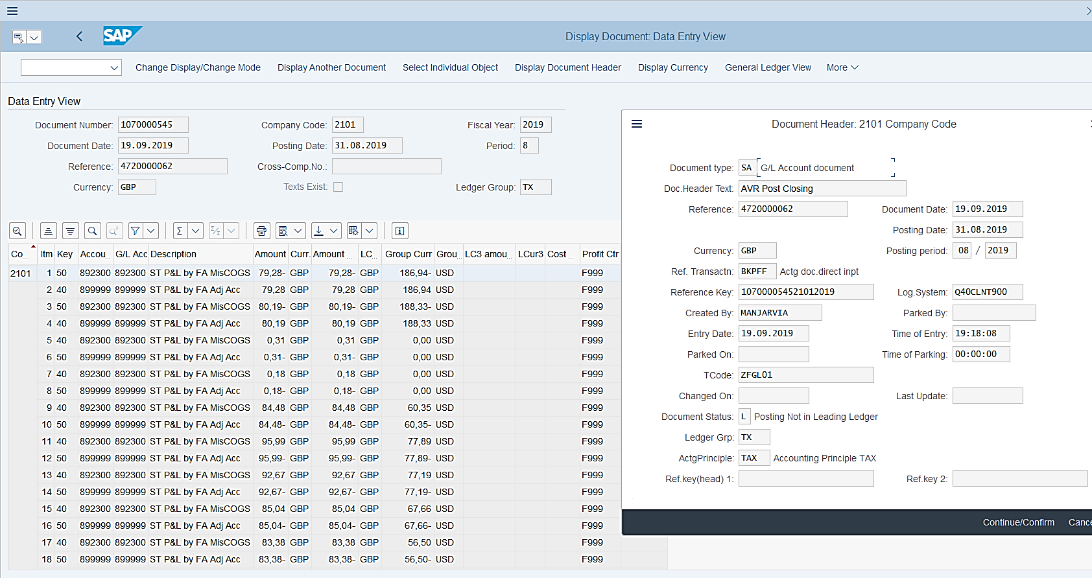
Functional Area Adjustment Posting Example
Functional Area Adjustment is posted with Document Type SA.
From P5 2020 ZFGL01 is integrated in FCC. Postings made prior to this are posted manually by GBS users.
Functional Area Adjustment is executed for specific accounting principles (STAT and/or TAX) in specific ledgers as required by entities.
The Accounting Entries are as described on the previous slide: re-posted to Functional Area adjustment GL accounts 89XXXX against 899999.

Slide 7
Demonstration & exercises
Exercise No. 6: Perform Functional Area Adjustments using T-Code ZFGL01

